Slide 2
Introduction & Problem
Brief background on VPPs and EVs
Challenges in optimal control of VPPs

Slide 3
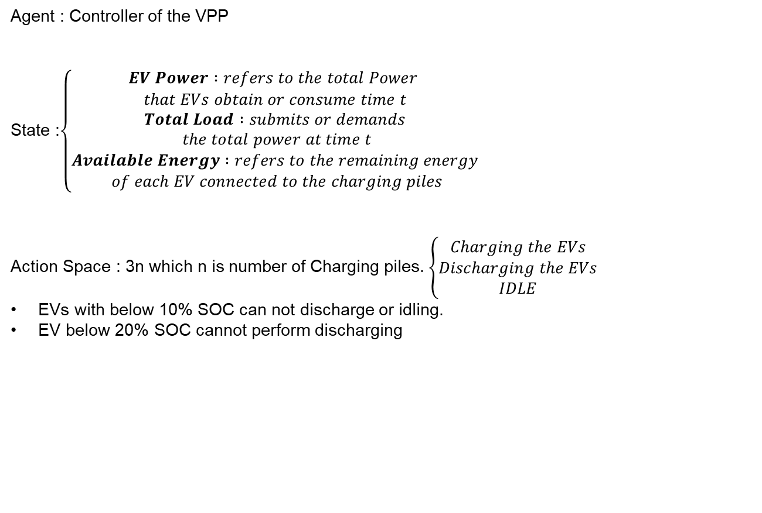
Markov decision process
Agent : Controller of the VPP
State :$\left\{\begin{aligned}EV Power :refers to the total Power \\ that EVs obtain or consume time t \\ Total Load :submits or demands \\ the total power at time t \\ Available Energy :refers to the remaining energy \\ of each EV connected to the charging piles\end{aligned}\right.$
Action Space : 3n which n is number of Charging piles. $\left\{\begin{aligned}Charging the EVs \\ Discharging the EVs \\ IDLE\end{aligned}\right.$
EVs with below 10% SOC can not discharge or idling.
EV below 20% SOC cannot perform discharging

Slide 4
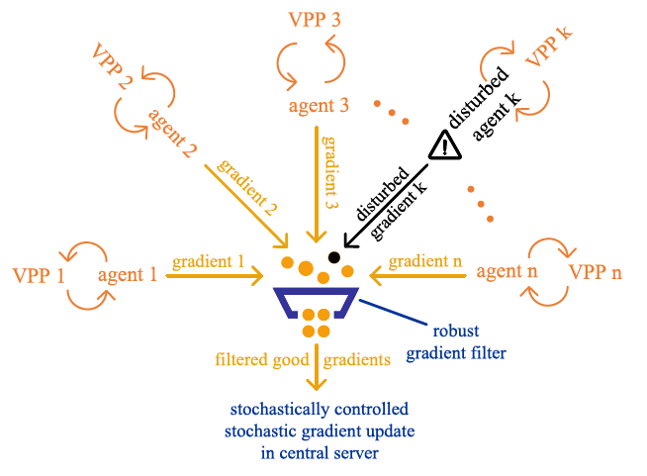
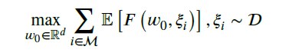
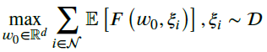
Markov decision process
Reward Function : Controller of the VPP
Robustness:

Slide 5
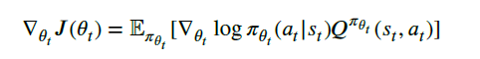
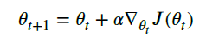
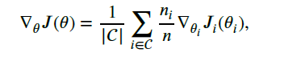
Methods
Policy-based deep reinforcement learning :
Federated deep reinforcement learning :
*FDRL combines the benefits of distributed policy learning and privacy
preservation by allowing clients to learn from their own data while
keeping it private. Additionally, FDRL can improve data efficiency by
allowing multiple clients to learn from their local data and share their
knowledge with the global model.

Slide 6
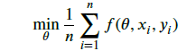
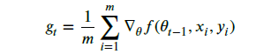
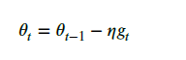
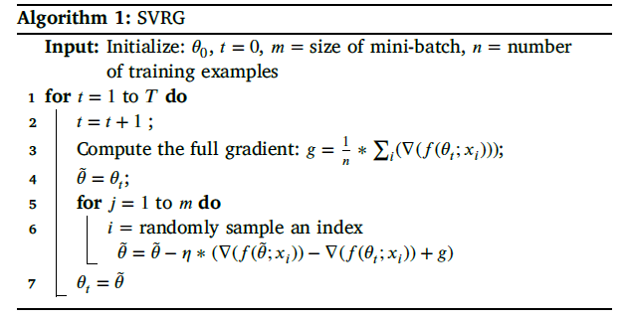
Methods (SGD)
Stochastic variance reduced gradient : solve slow convergence rates problem
At each iteration, SVRG computes the full gradient of the objective
function using the entire training dataset.

Slide 7
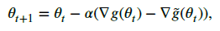
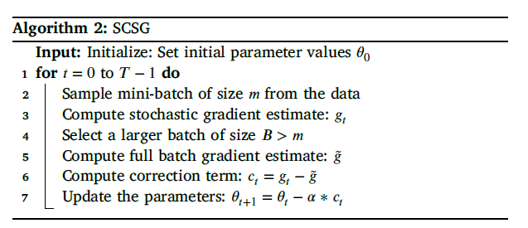
Methods (SGD)
Stochastically controlled stochastic gradient : aims to improve the
Convergence.
SCSG maintains a history of previous gradients and their corresponding values

Slide 8
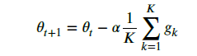
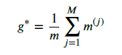
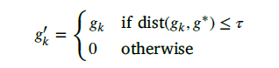
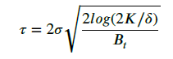
Methods (Robust gradient filter)

Slide 9
Methods (Robustness modeling and settings)
Random Noise Disturbance (ND): comes from communication noises, uniform distribution, potentially causing the model to converge to different solutions or influencing the speed of convergence.
Stochastic Action Disturbance (AD): This disturbance mimics
scenarios like system failures or hardware faults that could lead to
unpredicted actions. a random action in a uniformly from the action space.
Inverting Sign Disturbance (SD): This disturbance represents potential
cyber-attacks where the attacker might manipulate the gradient
information to mislead the learning process.

Slide 10
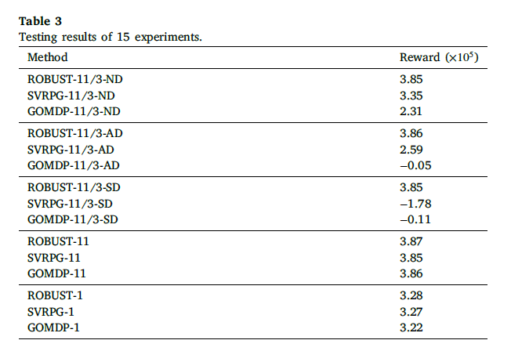
Result:

Slide 11
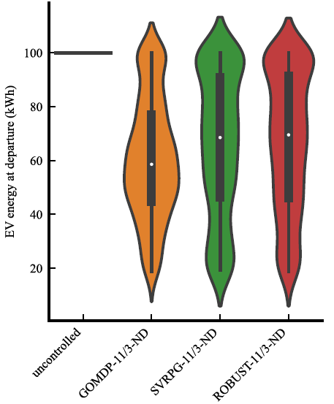
Result:

Slide 12
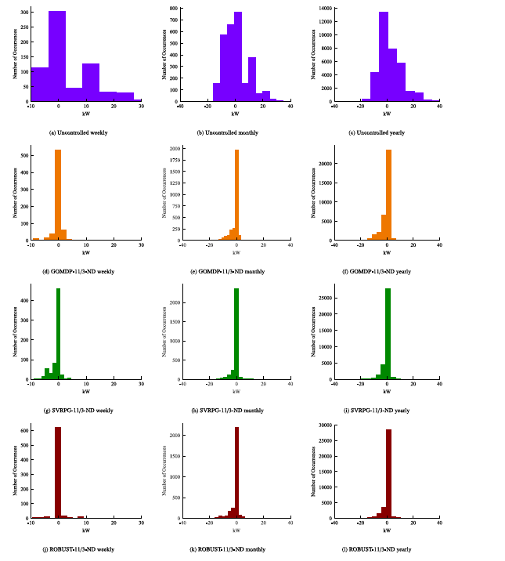
Result:

Slide 13
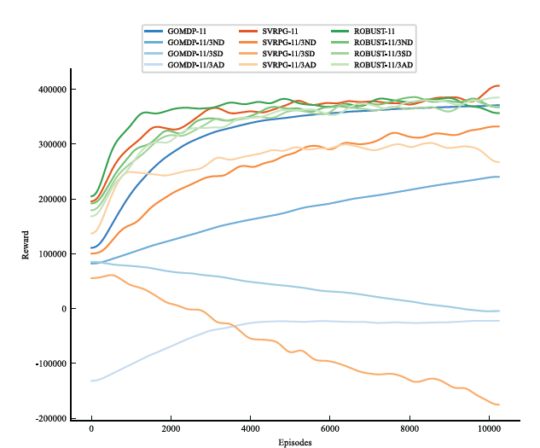

Slide 14
Thank you for your time and attention 🙂

Slide 16
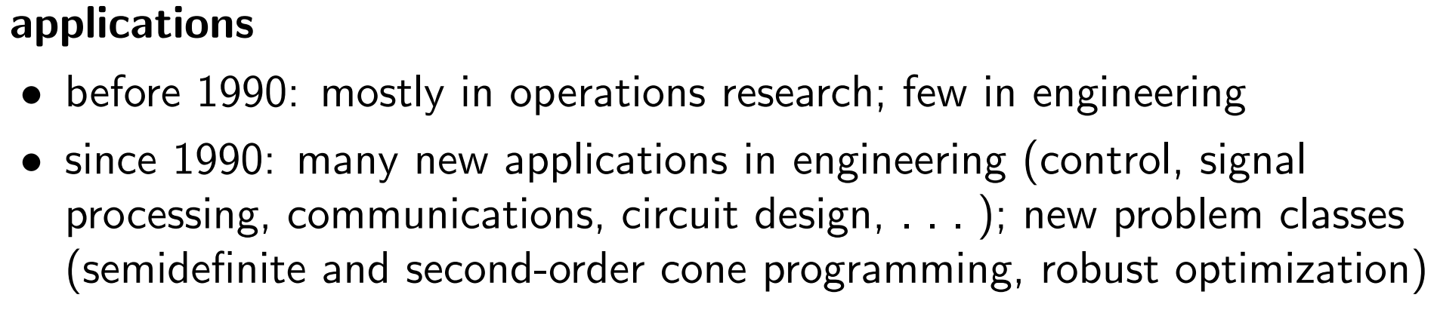
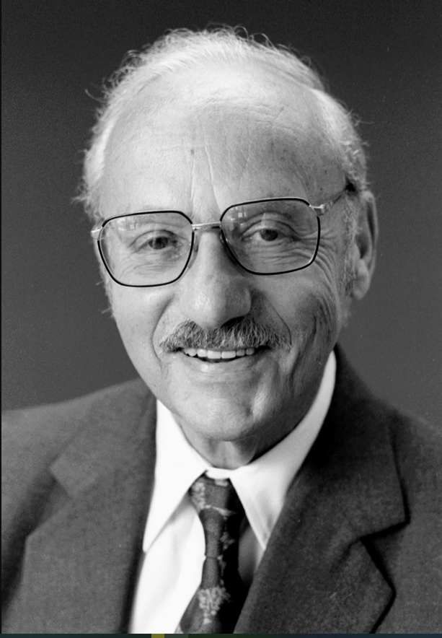
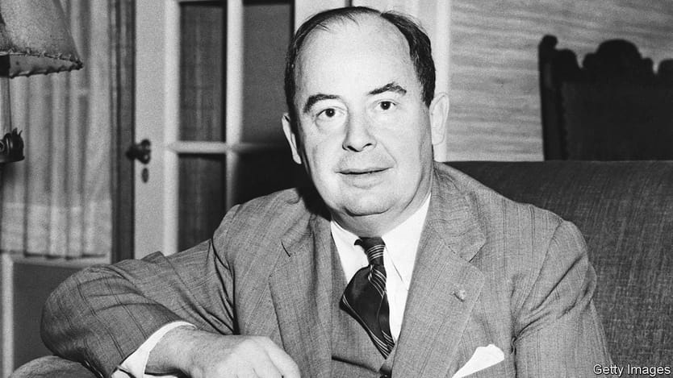
Brief history of convex optimization
Notes:
دانتزیگ و فان نویمن.
Building on his results on matrix games and on his model of an expanding economy,
when George Dantzig described his work in a few minutes. von Neumann invented the theory of duality in linear programming
Von Neumann's algorithm was the first interior point method of linear programming.

Slide 17

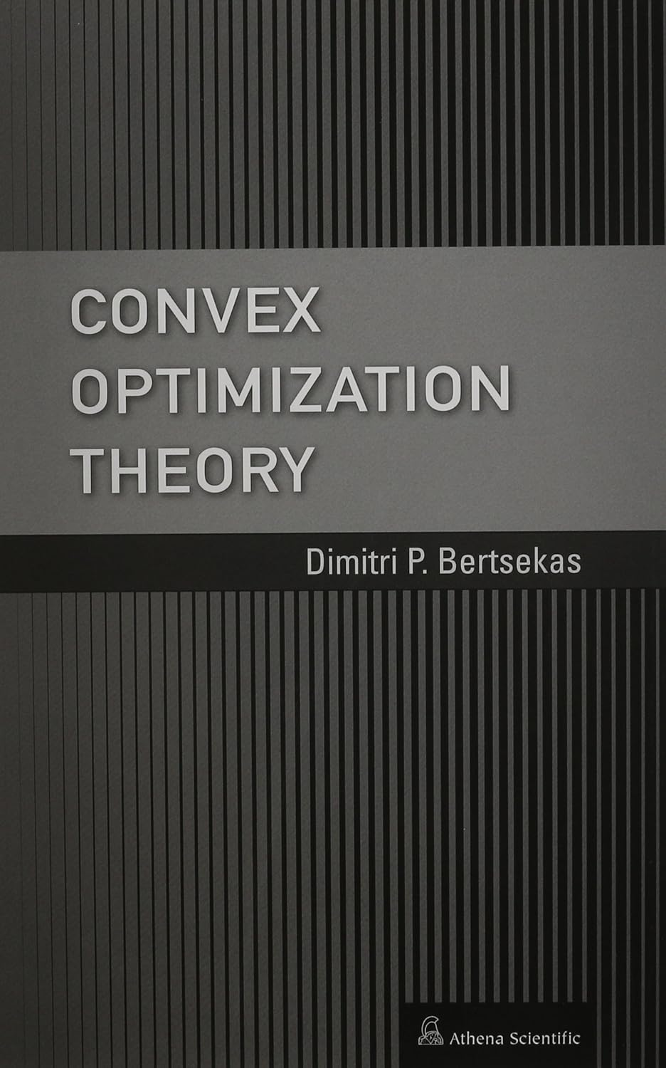
Best Convex Optimization References

Slide 18
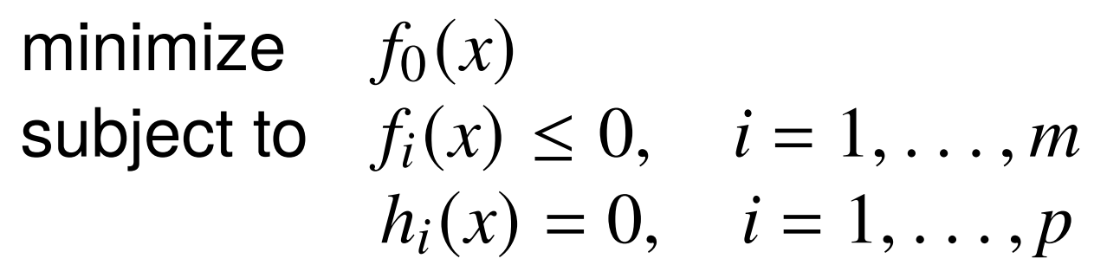
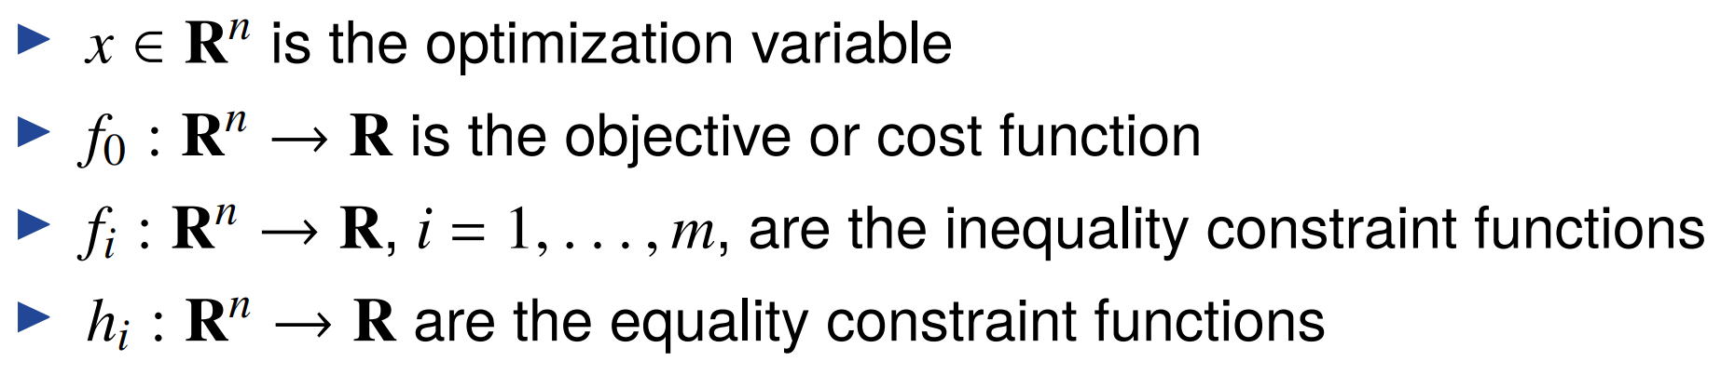
Optimization problem in standard form

Slide 19
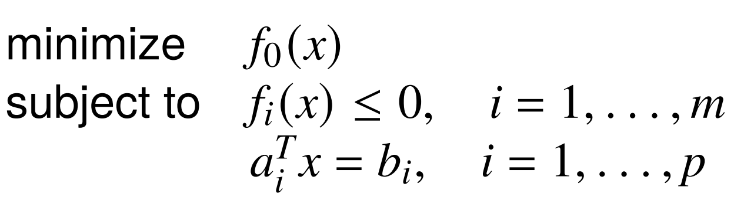
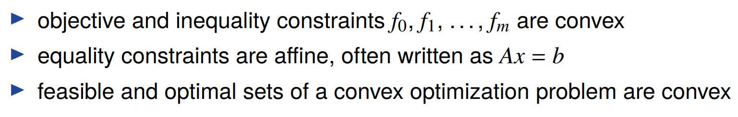
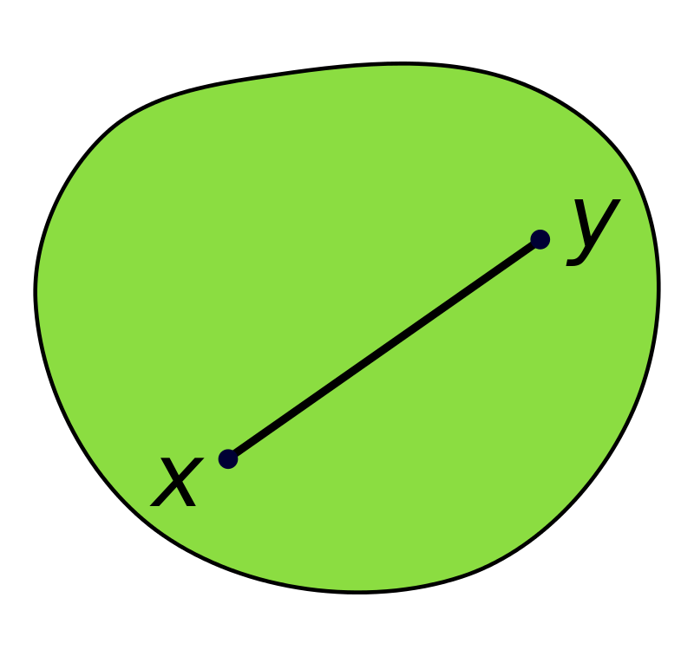
Standard form convex optimization problem
Notes:
شهود دو بعدی ما در ابعاد بالا هم جواب میده و با ریاضیات سازگار هست.

Slide 20
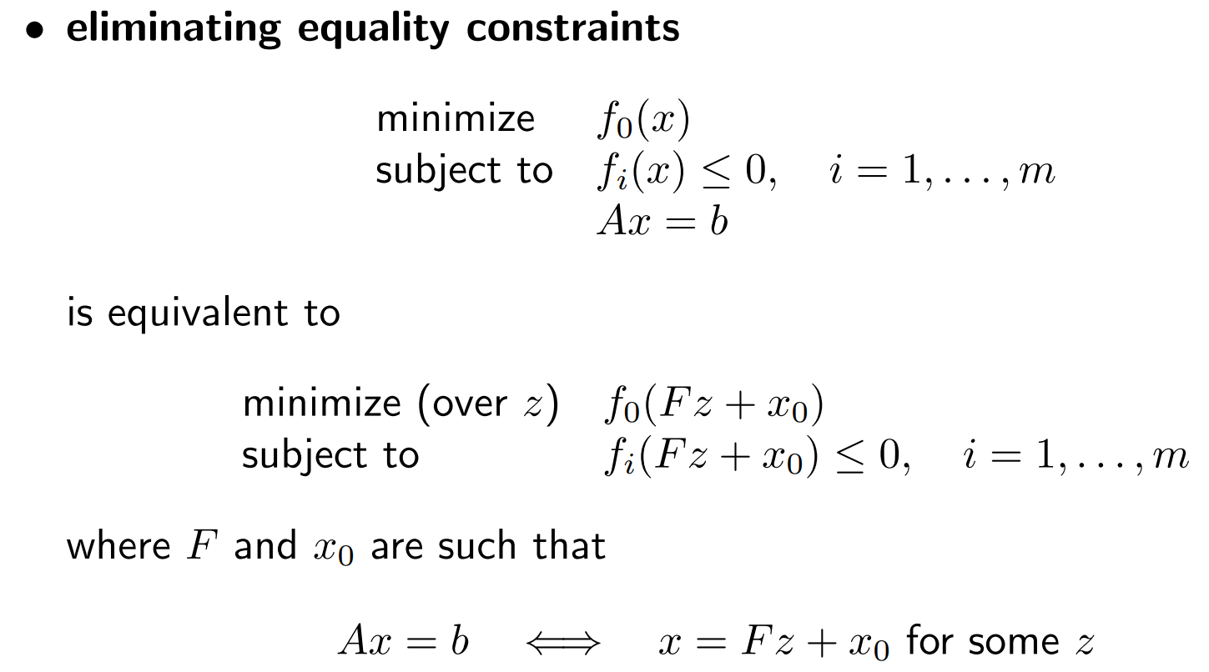
Equivalent Convex Problems 1

Slide 21
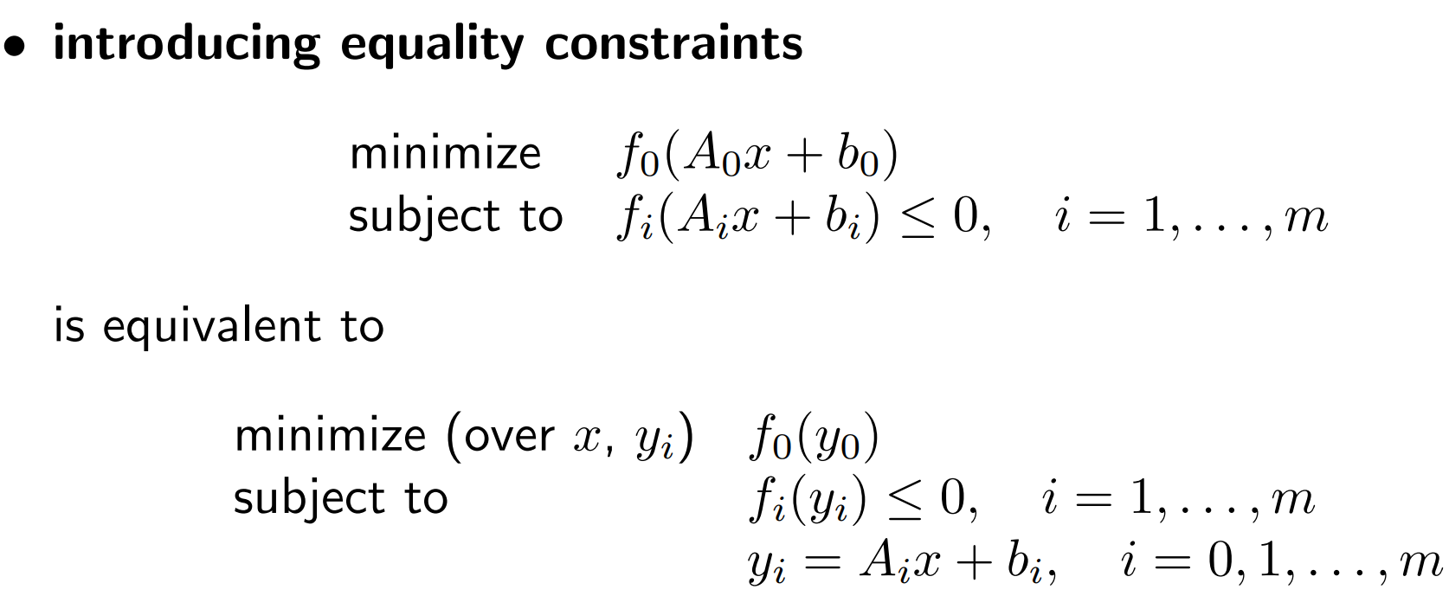
Equivalent Convex Problems 2

Slide 22
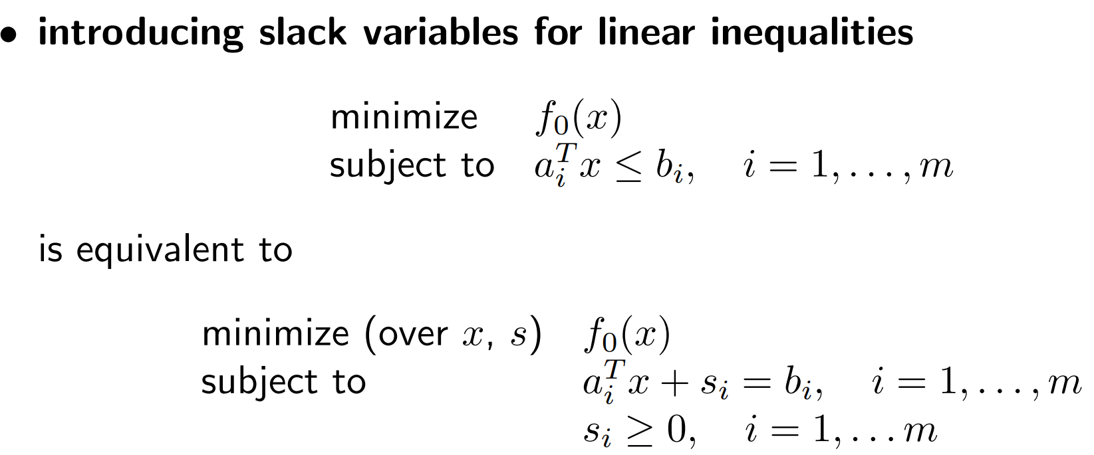
Equivalent Convex Problems 3

Slide 23
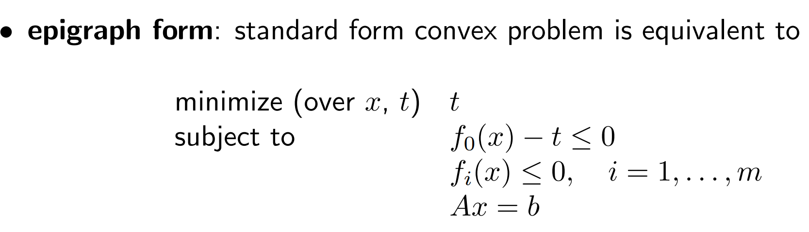
Equivalent Convex Problems 4

Slide 24
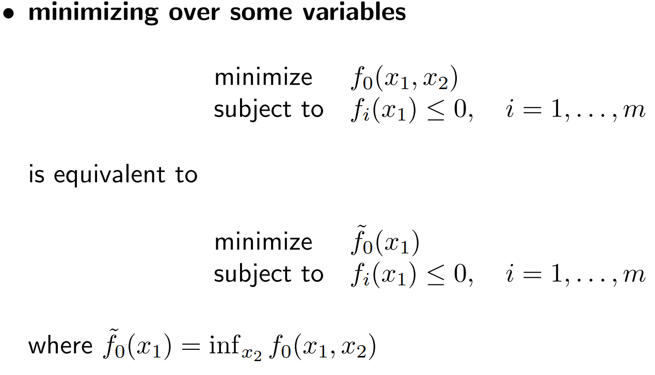
Equivalent Convex Problems 5

Slide 25
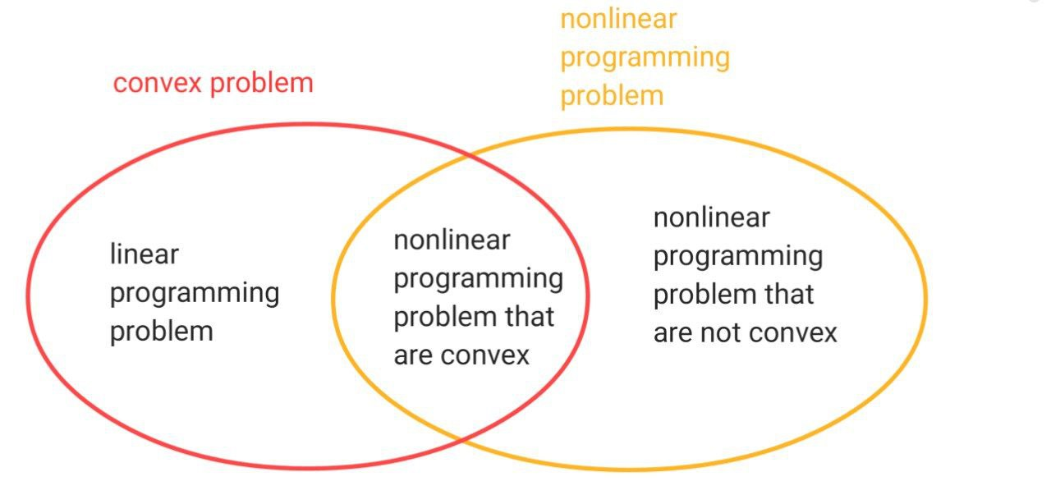
Nonlinear Programming Vs Convex Optimization

Slide 26
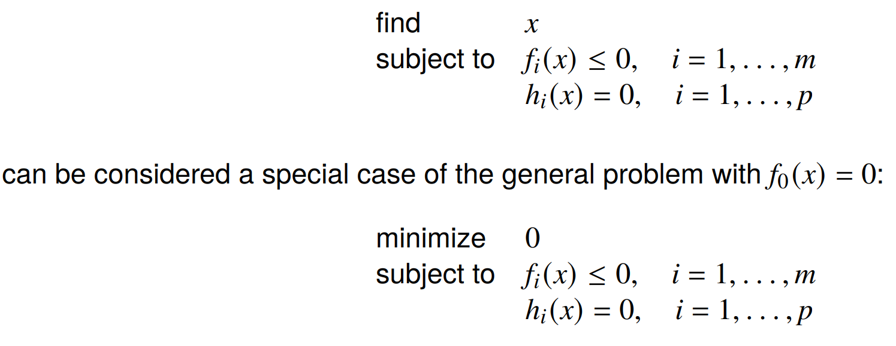
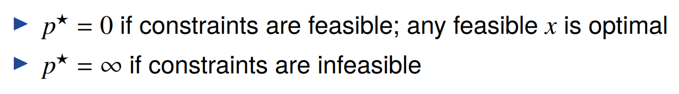
Feasibility problem

Slide 27
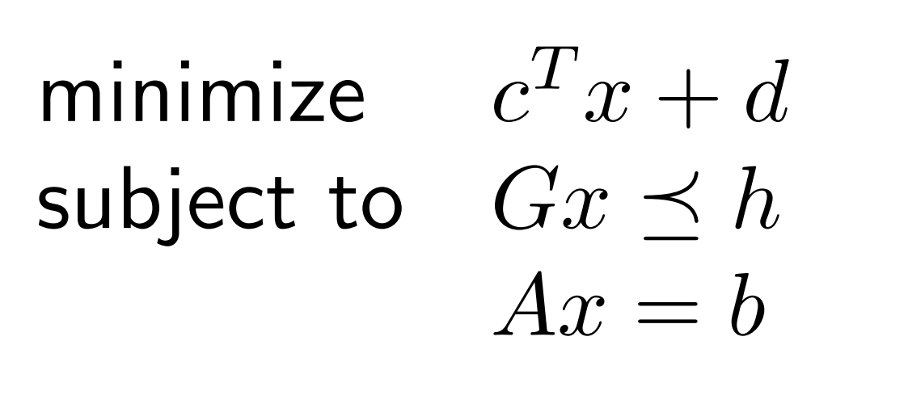
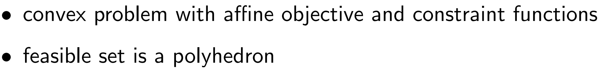
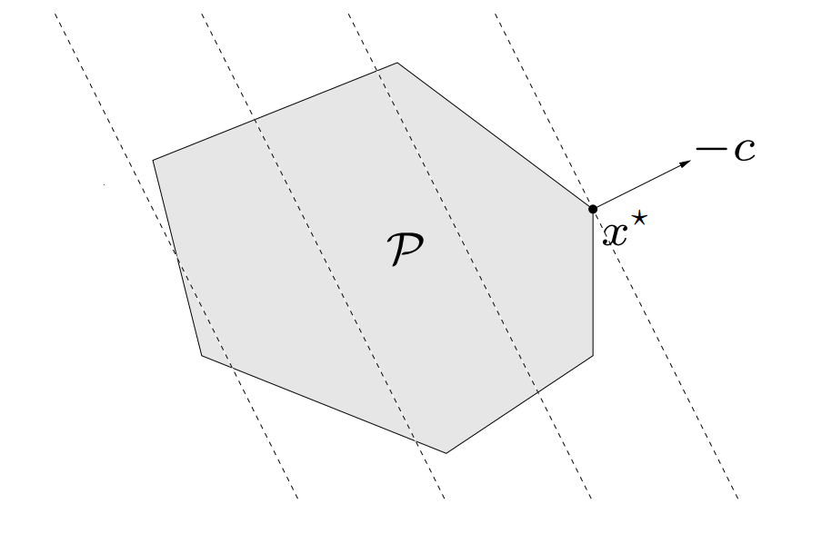
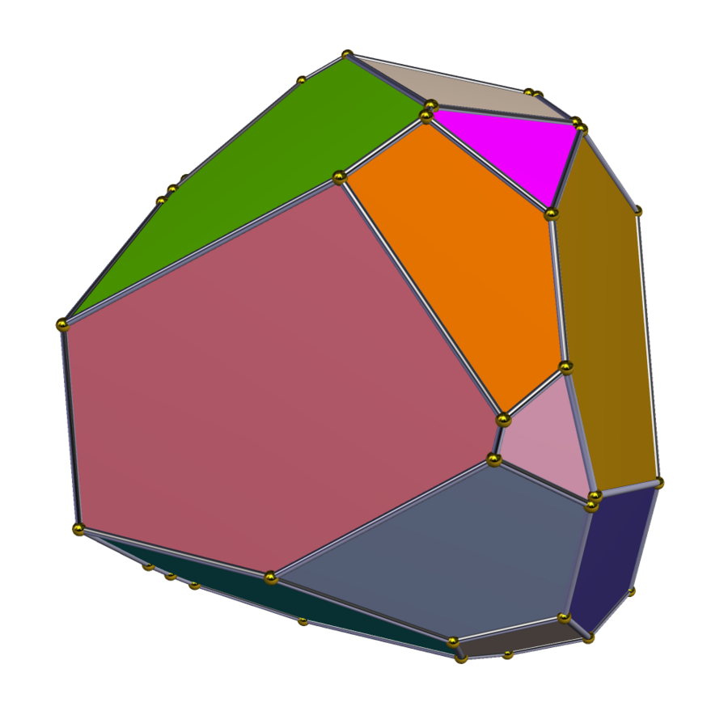
Linear Program (Theory of systems of linear inequalities)
Notes:
A convex polytope is sometimes defined as the intersection of a set of half-spaces.
A polygon is a 2-dimensional figure with flat 1-D sides such as a triangle.
A polyhedron is a 3-dimensional object with flat 2-D faces such as a cube.
A polytype is a N-dimensional object that has “flat” (N-1) dimensional “edges”. Thus polygons and polyhedrons are both polytypes.
theory of systems of linear inequalities

Slide 28
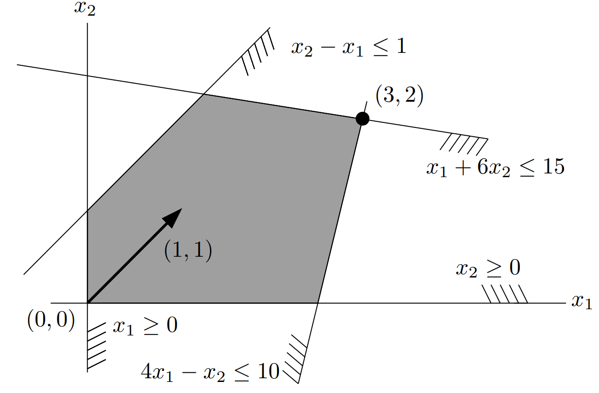
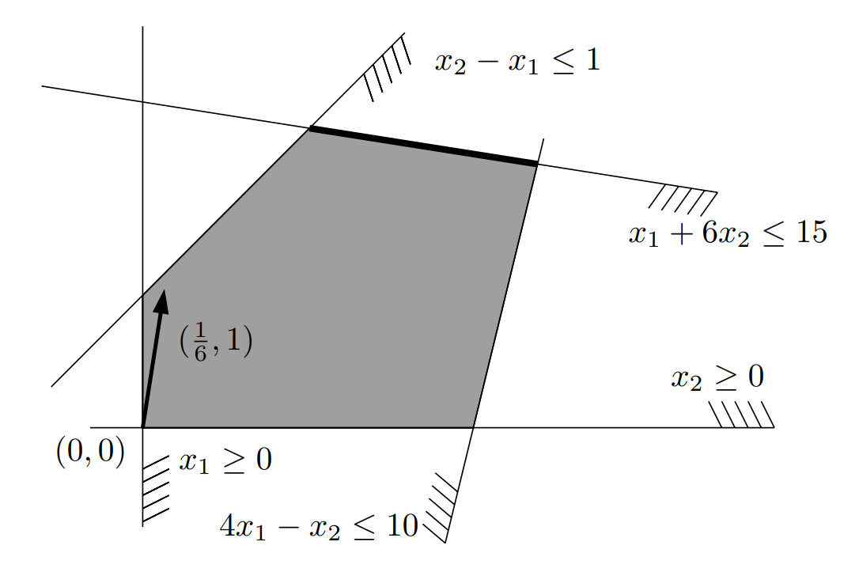
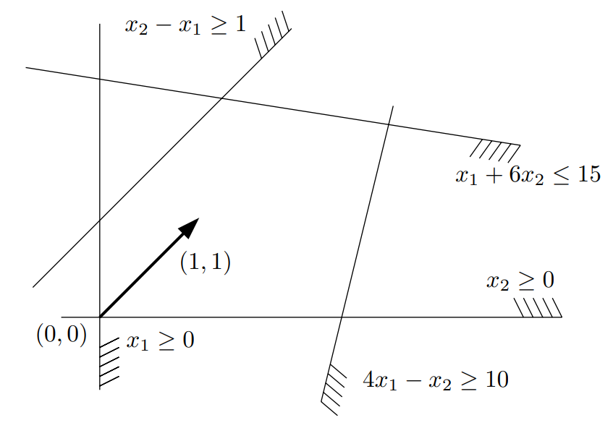
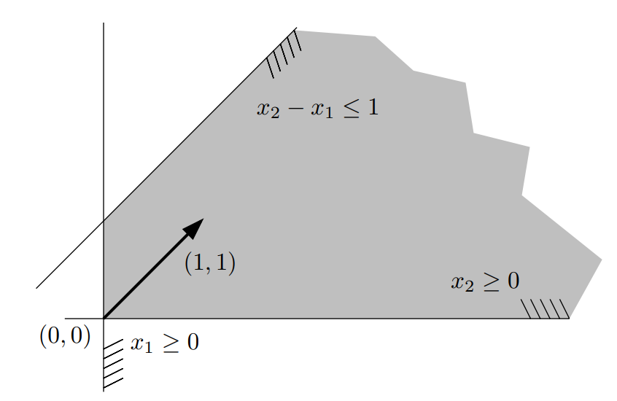
LP Scenarios

Slide 29
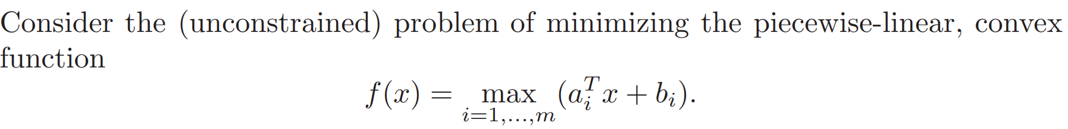
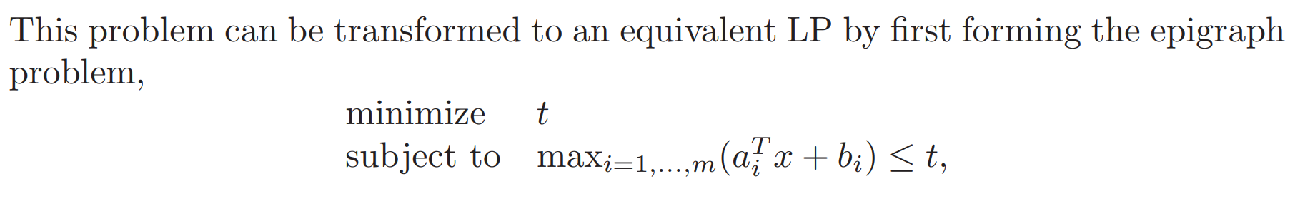
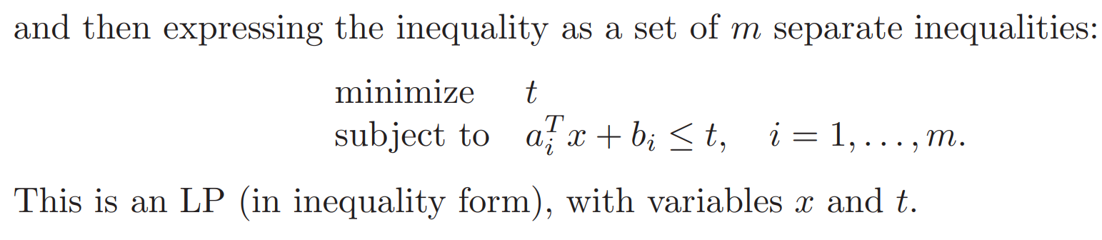
LP (Example2)

Slide 30
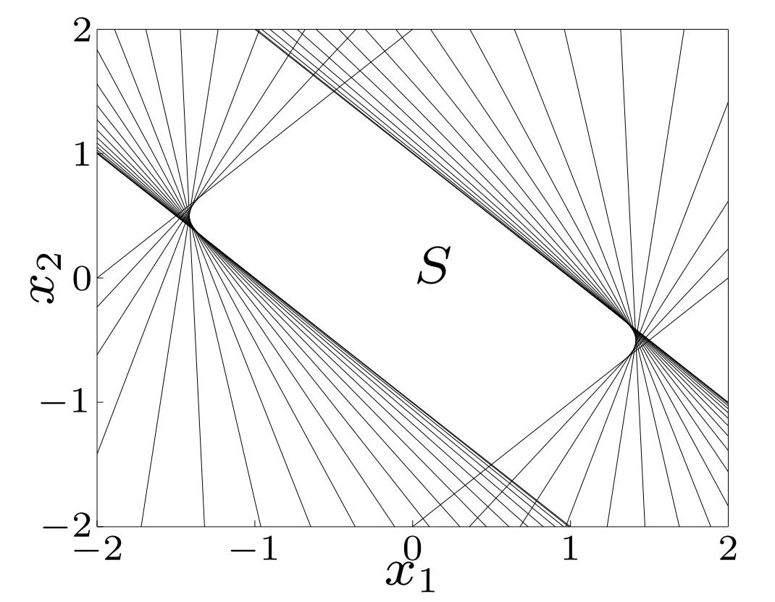
Convex Set Approximation

Slide 31



Quadratic Program (QP)

Slide 32

Quadratic Function

Slide 33




QP (Examples)
Least Square
(Linearly) Constrained Least Square
Least norm (Special case of CLS)
Notes:
CLS تحت یک شرایط خاص حل بسته داره.
همینطور مسئله least norm هم حل بسته داره.

Slide 34


Piecewise-polynomial fitting (QP Example)
Notes:
مسئله شبیه‌ به Spline interpolation هست.

Slide 35

Piecewise-polynomial fitting (QP Example)
“To kill mosquitoes you don't need Atomic Bomb.”

Slide 36


Piecewise-polynomial fitting (QP Example)

Slide 37


Quadratically Constrained Quadratic Program (QCQP)
Notes:
LP c QP c QCQP

Slide 38



Cone Set

Slide 39

Cone Set (Question!)
Notes:
Is this Set a Cone?
Is this Cone is a Convex cone?

Slide 40


Convex Cone Set

Slide 41



Norm Cones
For the Euclidean norm this is a Second-order Cone.
Notes:
متغیر t همواره مثبت است.

Slide 42




Second Order Cone Program (SOCP)
Notes:
متغیر t همواره مثبت است.

Slide 43

Robust Linear Programming

Slide 44


Robust Linear Programming

Slide 45



Robust Linear Programming as a SOCP
Notes:
اپسیلون آی: ی بیضی هست که مرکزش ai هست محورهاش بردارهای ویژه Pi ها هستن.
اگر Pi برابر با صفر باشه یعنی ai کاملاً شناخته شده هست.

Slide 46




Robust Linear Programming as a SOCP
Notes:
فرض شده که ai ها برداری از متغیرهای تصادفی گوسی هستند که مستقل ااز هم هستند.
میانگین aiبار
واریانس sigma

Slide 47

Convex Optimization Hierarchy

Slide 48
Question Time!

